Slide 1
Intensity Transformation
- Chao
- Gauri
- Charan
- Saikiran

Slide 2
Intensity Transformation
Objective
Modify the image intensities for better visualization.
Sub topics
Image negatives
Log transformation
Power-Law (Gamma) transformation
Histogram
Histogram equalization
Histogram matching

Slide 3
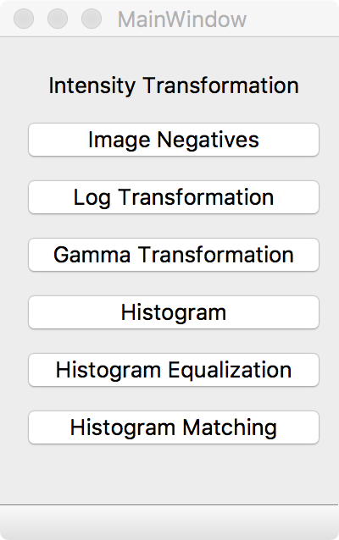
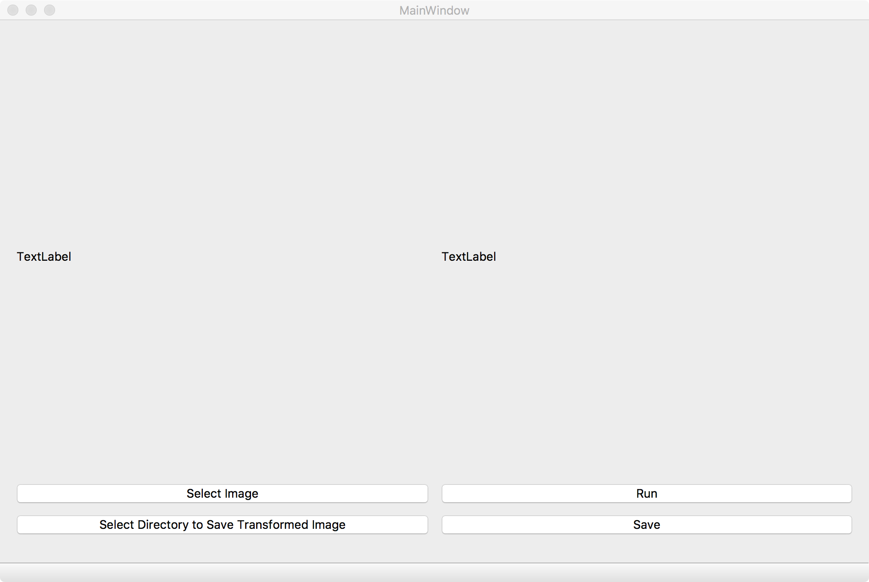
UI

Slide 4
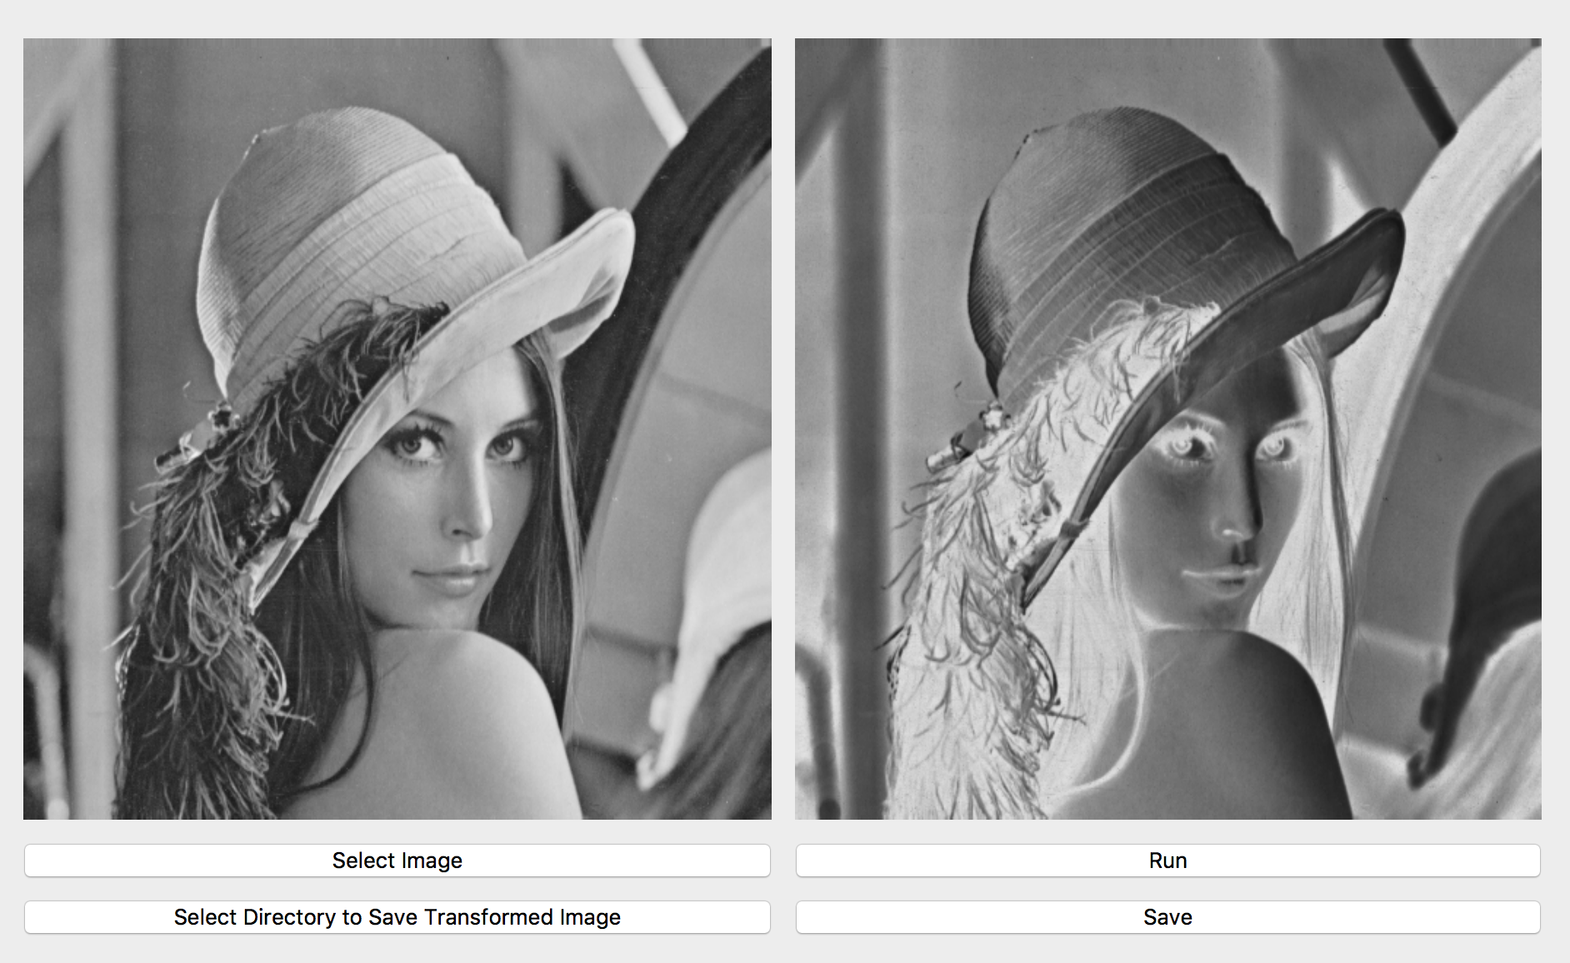
Image negatives

Slide 5
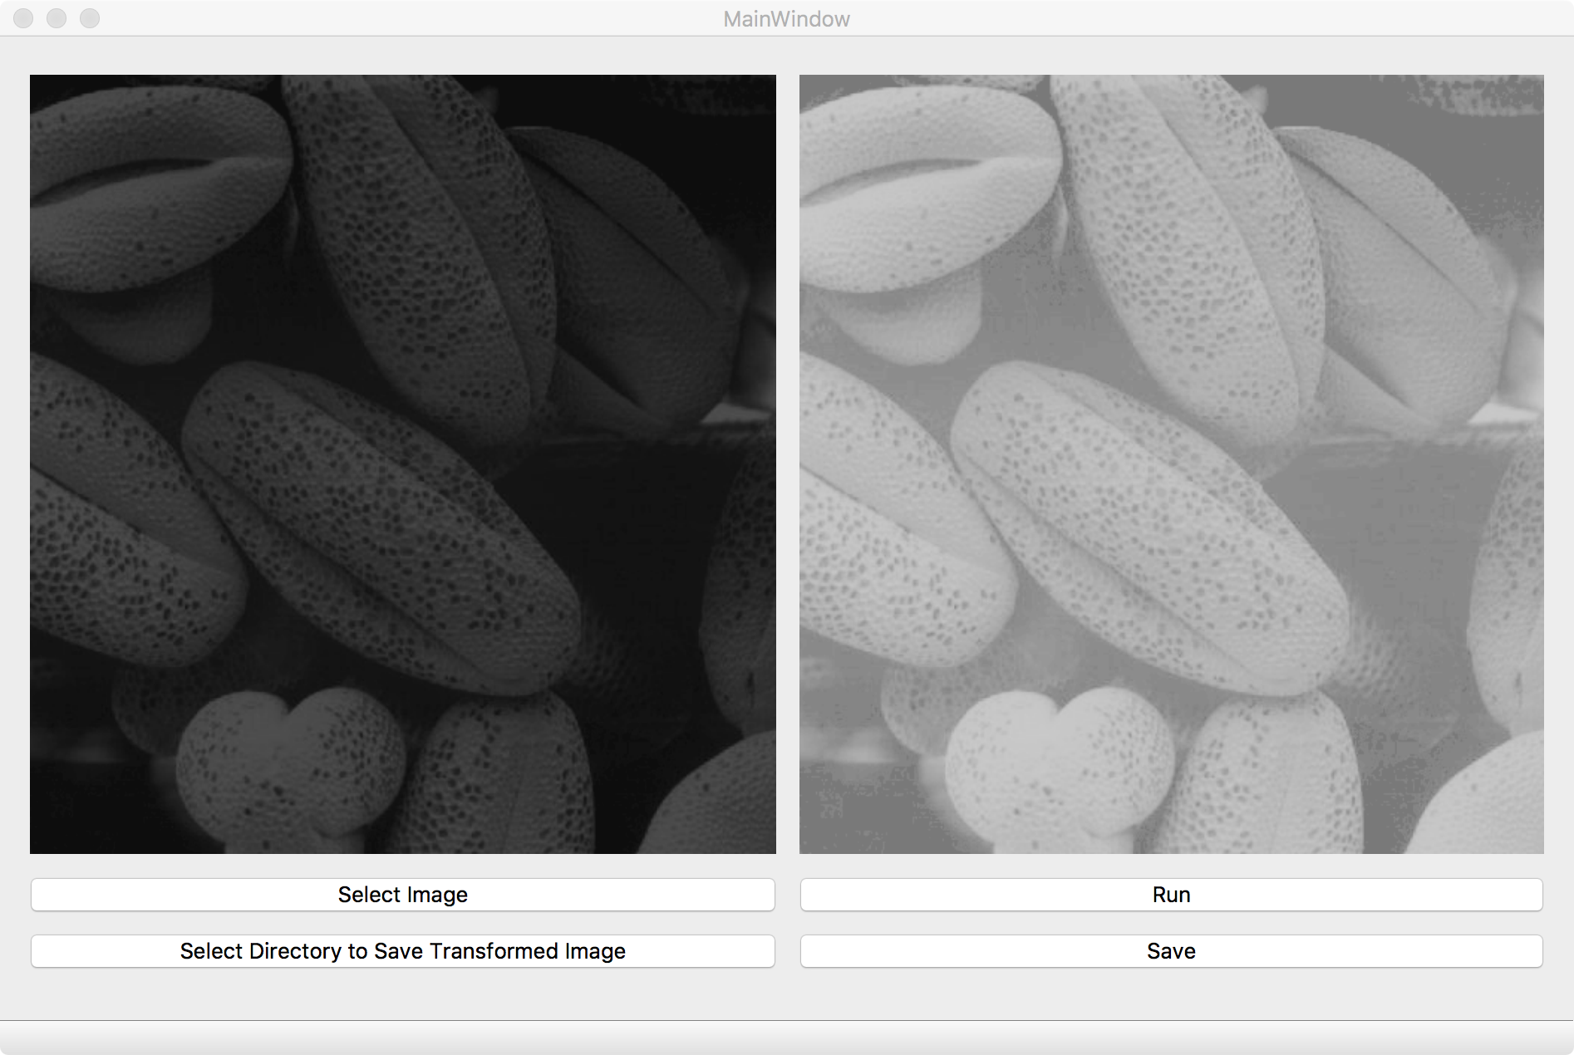
Log transformation

Slide 6
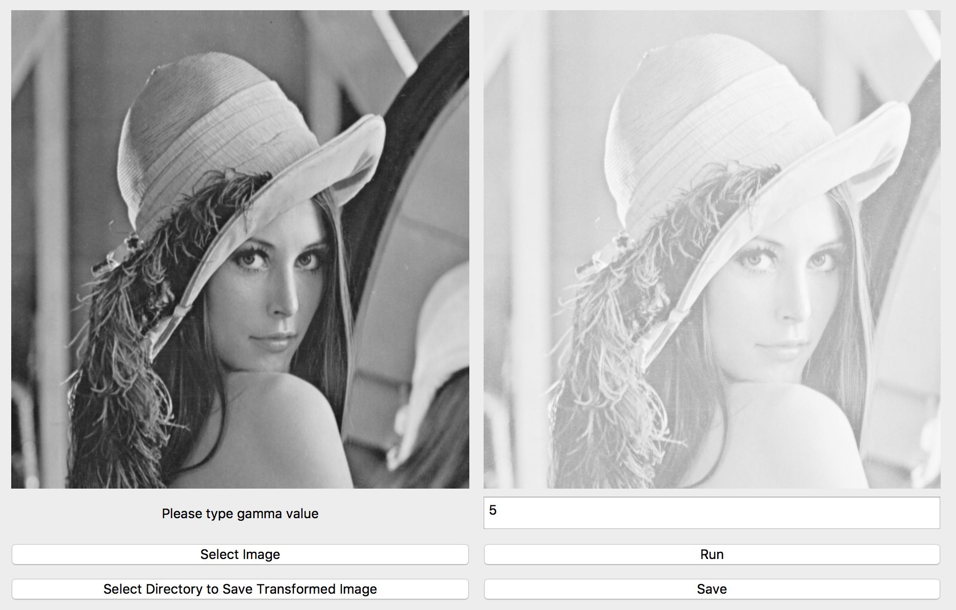
Power-Law (Gamma) transformation

Slide 7
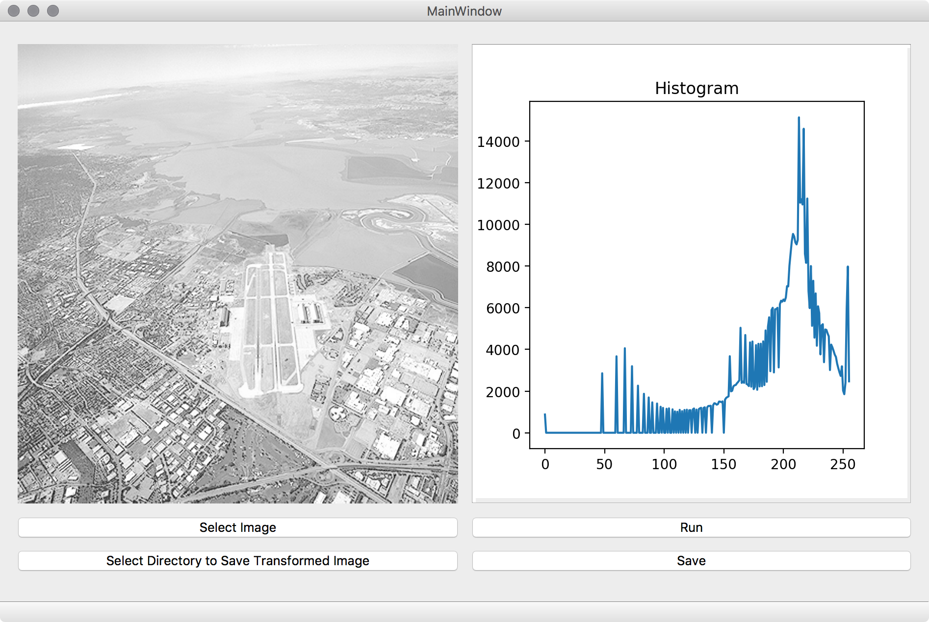
Histogram

Slide 8
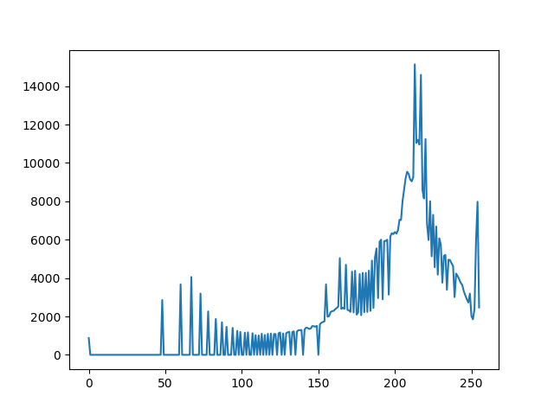
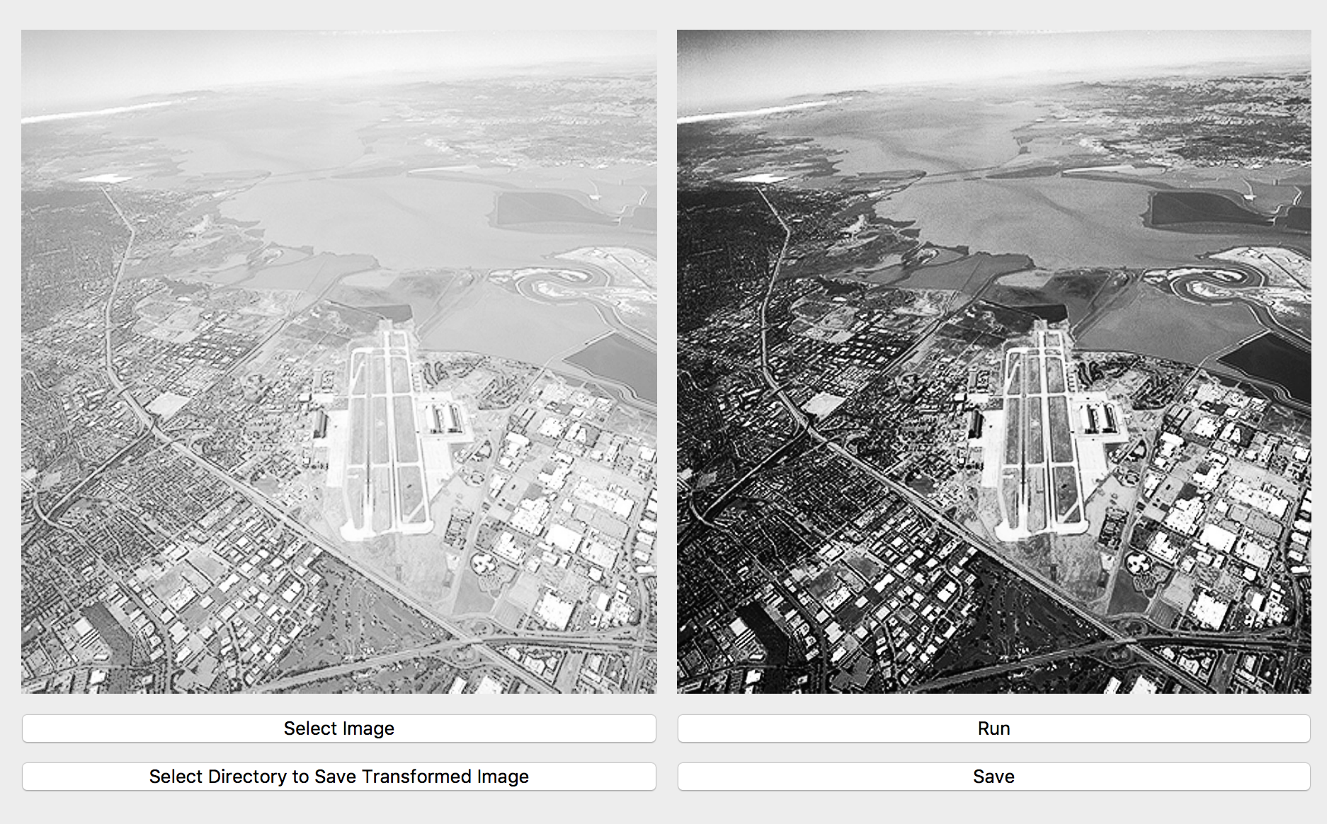
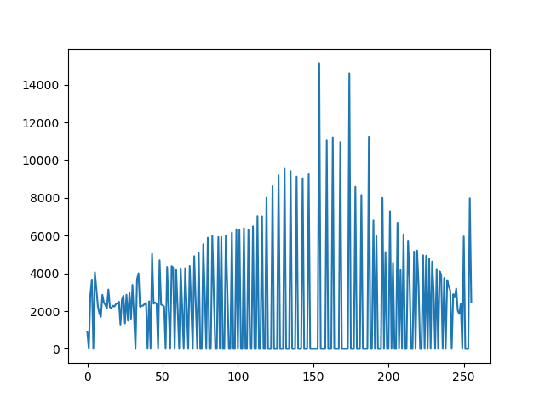
Histogram equalization

Slide 9
Thank you

